Slide 1
Transformers
The next word prediction

Slide 2
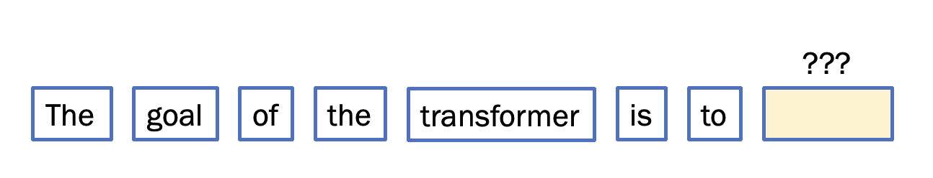
Attention
Multi-Layered Perceptron
Attention
Multi-Layered Perceptron
Attention
Multi-Layered Perceptron

Slide 3
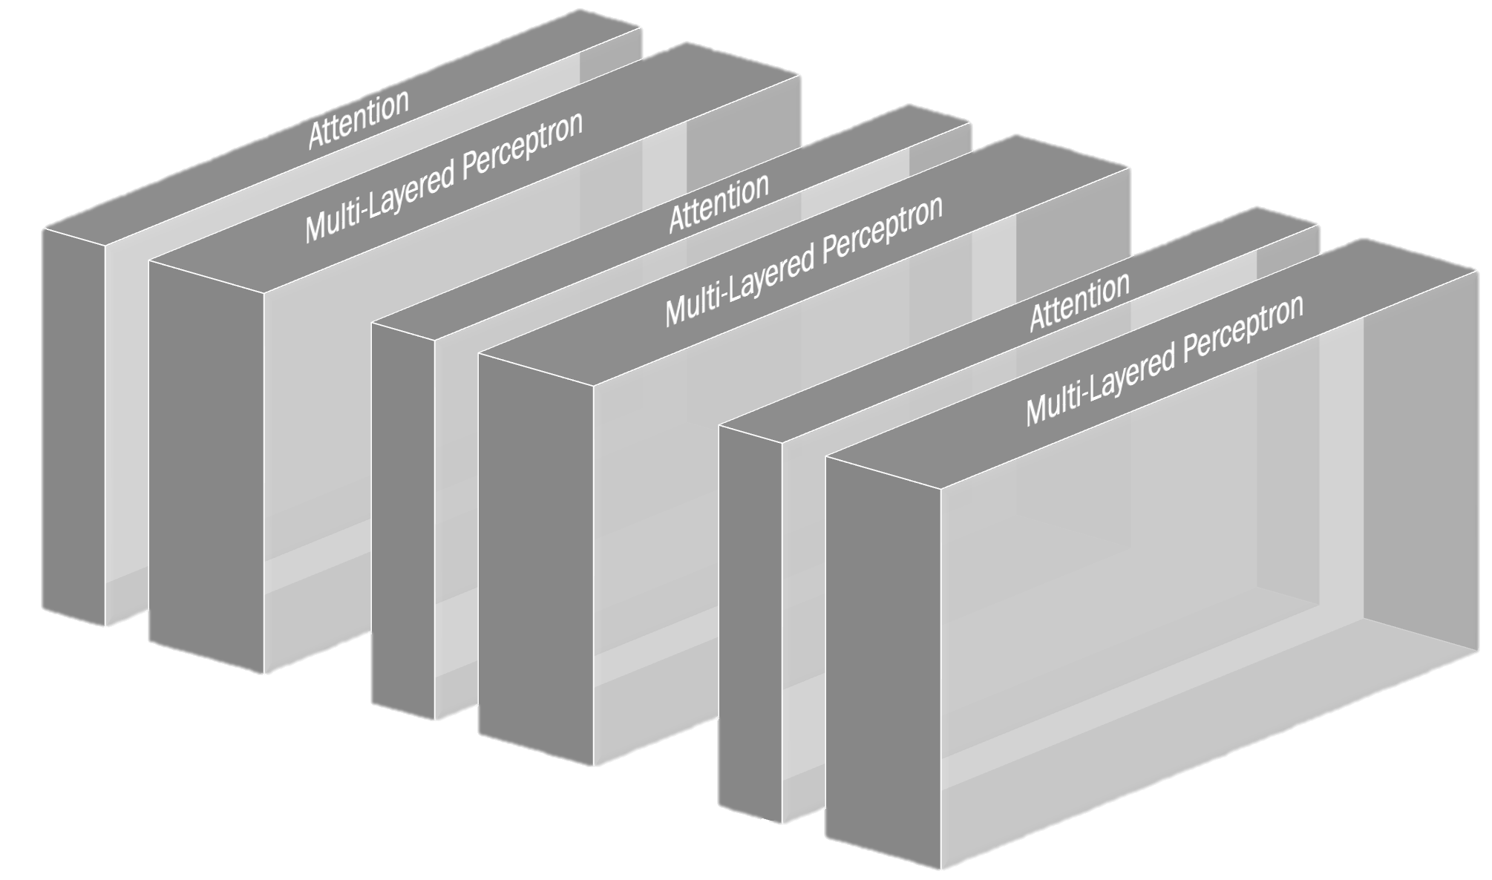
Attention: 1/3
GPT-3
MLP: 2/3
96 heads
96 layers

Slide 4
Step 1. Unembedding

Slide 5
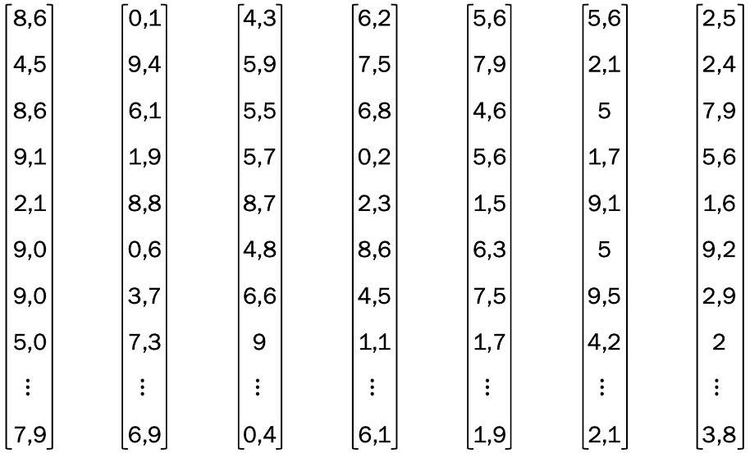
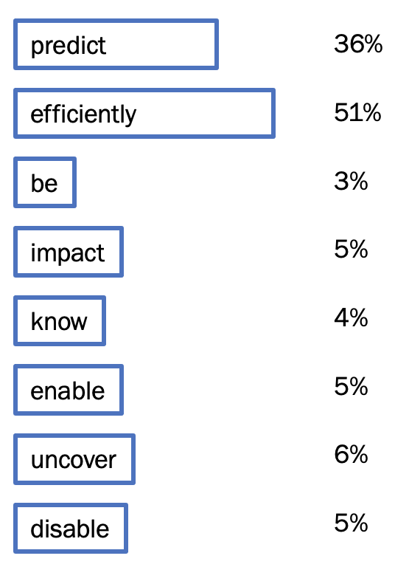
The prediction of the next token is the function of the last vector in the sequence

Slide 6
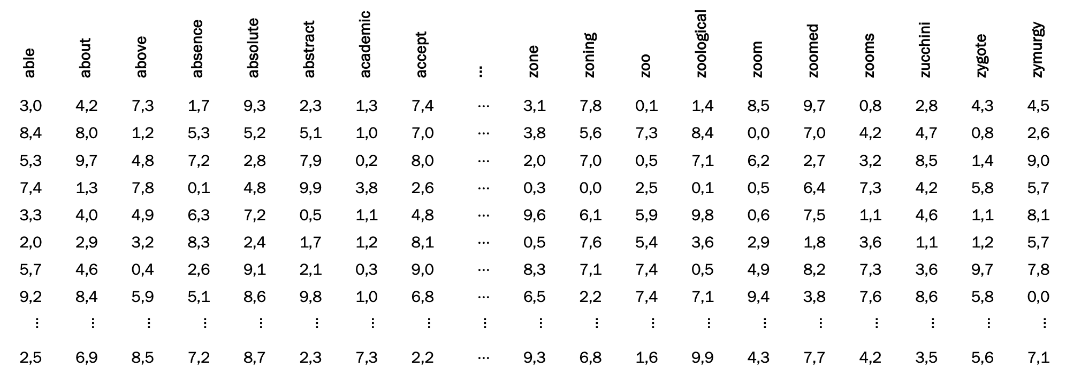
We started with the embeddings set for all the words in our dictionary

Slide 7

Now, we need to transform the embedding of the last word into a list corresponding to all the words in the dictionary
~50 ths

Slide 8



$WU$: unembedding matrix
$$WU$$
=
50,277
12,288

Slide 9
Step 2. Normalization

Slide 10

Softmax
$$WU$$
softmax
50,277
=
12,288

Slide 11
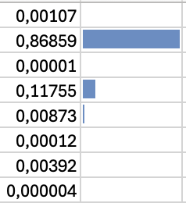
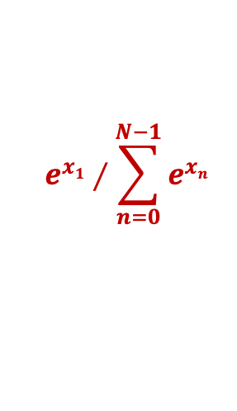
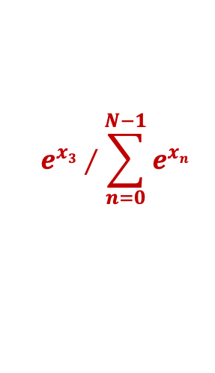


Softmax
$$e^{x1}∕\sum_{n=0}^{N−1}{e^{xn}}$$
-1,5
5,2
-6,3
3,2
0,6
-3,7
-0,2
-7,0
$$e^{x2}∕\sum_{n=0}^{N−1}{e^{xn}}$$
=
$$e^{x3}∕\sum_{n=0}^{N−1}{e^{xn}}$$
$$⋮$$
$$e^{xN}∕\sum_{n=0}^{N−1}{e^{xn}}$$

Slide 12
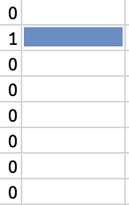
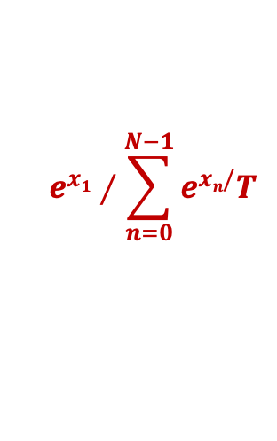
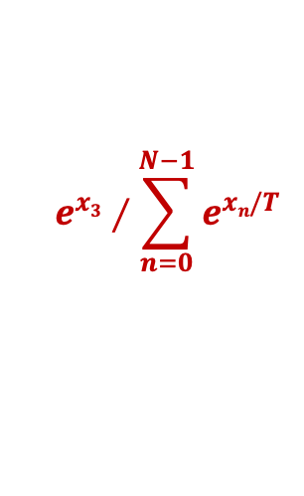
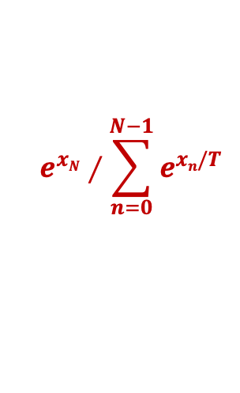
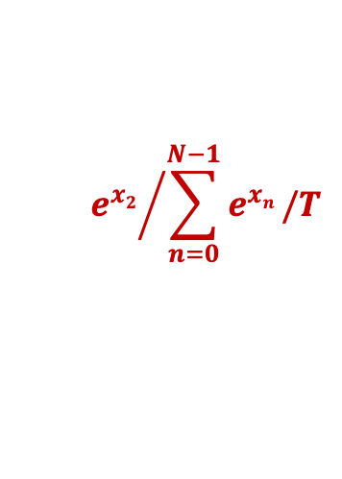
T = temperature
$$e^{x1}∕\sum_{n=0}^{N−1}{e^{xn/}T}$$
-1,5
5,2
-6,3
3,2
0,6
-3,7
-0,2
-7,0
-1,5
5,2
-6,3
3,2
0,6
-3,7
-0,2
-7,0
$${e^{x2}}/{\sum_{n=0}^{N−1}{e^{xn}}}/T$$
T = 0
=
$$e^{x3}∕\sum_{n=0}^{N−1}{e^{xn/T}}$$
$$⋮$$
$$e^{xN}∕\sum_{n=0}^{N−1}{e^{xn/T}}$$

Slide 13
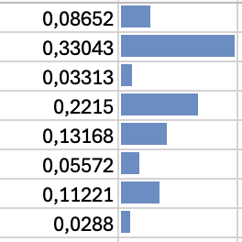
T = temperature
$$e^{x1}∕\sum_{n=0}^{N−1}{e^{xn/}T}$$
-1,5
5,2
-6,3
3,2
0,6
-3,7
-0,2
-7,0
-1,5
5,2
-6,3
3,2
0,6
-3,7
-0,2
-7,0
$${e^{x2}}/{\sum_{n=0}^{N−1}{e^{xn}}}/T$$
T = 5
=
$$e^{x3}∕\sum_{n=0}^{N−1}{e^{xn/T}}$$
$$⋮$$
$$e^{xN}∕\sum_{n=0}^{N−1}{e^{xn/T}}$$

Slide 14
Step 3. Selection

Slide 15
top_k
$$e^{x1}∕\sum_{n=0}^{N−1}{e^{xn/}T}$$
-1,5
5,2
-6,3
3,2
0,6
-3,7
-0,2
-7,0
-1,5
5,2
-6,3
3,2
0,6
-3,7
-0,2
-7,0
$${e^{x2}}/{\sum_{n=0}^{N−1}{e^{xn}}}/T$$
k = 3
=
$$e^{x3}∕\sum_{n=0}^{N−1}{e^{xn/T}}$$
$$⋮$$
$$e^{xN}∕\sum_{n=0}^{N−1}{e^{xn/T}}$$

Slide 16
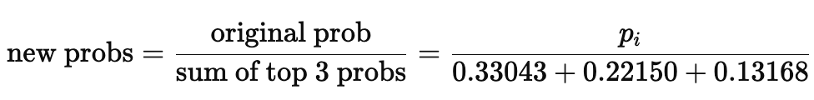
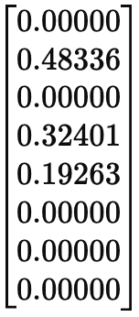
top_k
k = 3
Sample one from these 3 tokens with the corresponding probability

Slide 17
top_k
new_probs = [0.00000, 0.48336, 0.00000, 0.32401, 0.19263, 0.00000, 0.00000, 0.00000]
import numpy as np
# Possible token indices (0 to 7)
token_indices = np.arange(len(new_probs))
# Sample 1 token from the distribution
sampled_token = np.random.choice(token_indices, p=new_probs)
print(f"Sampled token index: {sampled_token}")
k = 3
Sample one from these 3 tokens with the corresponding probability

Slide 18
top_p
$$e^{x1}∕\sum_{n=0}^{N−1}{e^{xn/}T}$$
$${e^{x2}}/{\sum_{n=0}^{N−1}{e^{xn}}}/T$$
Select the smallest subset of tokens whose cumulative probability exceeds a threshold p (e.g., 0.9)
=
$$e^{x3}∕\sum_{n=0}^{N−1}{e^{xn/T}}$$
$$⋮$$
$$e^{xN}∕\sum_{n=0}^{N−1}{e^{xn/T}}$$

Slide 19
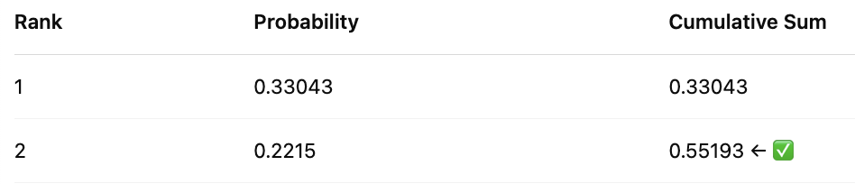
top_p = 0.5
Select the smallest subset of tokens whose cumulative probability exceeds a threshold p (e.g., 0.9)
Sampling:
59.89% chance → token at index 1
40.11% chance → token at index 3

Slide 20
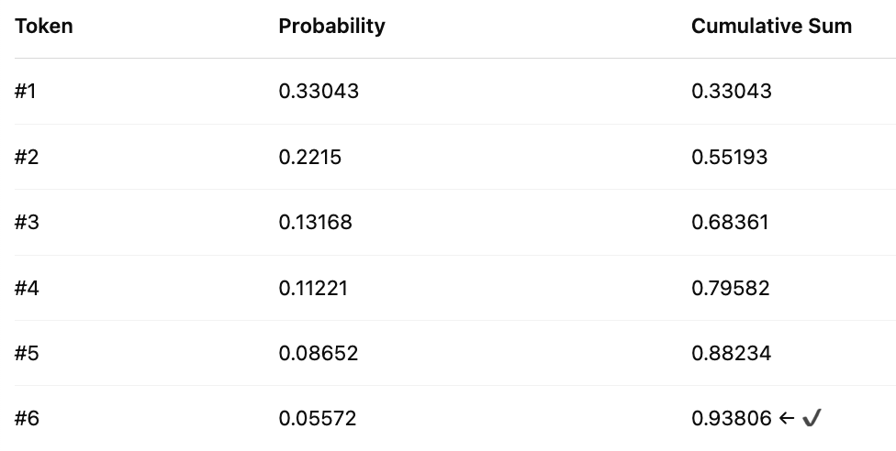
top_p = 0.9
Select the smallest subset of tokens whose cumulative probability exceeds a threshold p (e.g., 0.9)

